Slide 1
SOFTWARE ENGINEERING 2 · SECTION 4
Locators
and assertions
Last week the script opened pages. This week it finds the button, presses it, and checks what happened — on its own.
Eng. Mohamed Shehab · Faculty of Computers and Information, Menoufia University

Slide 2
FIRST, ONE THING FROM LAST WEEK
Two browsers open. Why?
public class FirstTest {
LINE 3
Chrome #1, when the class is built
WebDriver driver = new ChromeDriver();
@BeforeTest
public void prepare() {
LINE 7
driver = new ChromeDriver();
Chrome #2, before the test
}
}
THE RULE
One driver, one place
Field or @BeforeTest. Never both.
quit() only reaches the second one. The first stays open for ever.

Slide 3
LAST WEEK, TWO MORE THINGS
Every open tab, and two ways to close
String first = driver.getWindowHandle();
GETWINDOWHANDLE()
One String
driver.findElement(By.linkText(
The tab the driver is on now
"Open the Waits page in a new tab")).click();
Set<String> all = driver.getWindowHandles();
all.size(); // 2
GETWINDOWHANDLES()
A Set of every tab
for (String h : all) {
Loop over it to switch
driver.switchTo().window(h);
}
CLOSE() OR QUIT()
close(): this tab only
quit(): every tab, and the session ends
After close(), switch to another tab before you use the driver again.

Slide 4
TODAY
Find it. Act on it. Check it.
01 · FIND
02 · ACT
03 · CHECK
04 · REUSE
Locators
Click, type, read
Assertions
ElementActions
How the script points at one element
What you do once you found it
The step that turns a script into a test
Write it once, call it everywhere
At the end: one test that passes for a good user and catches every defect you found by hand last week.

Slide 5
01 · FIND
The script cannot see the button
You see a box that says Username. Selenium sees this:
<input class="input_error form_input" placeholder="Username" type="text"
data-test="username" id="user-name" name="user-name" value="">
TAG
ATTRIBUTES
VALUES
input
id name class data-test
"user-name"
What kind of element
Its labels
What you search for
A locator is a search: find the one element whose label has this value.

Slide 6
01 · FIND · ON YOUR LAPTOP NOW
Look at the HTML yourself
1
2
3
4
Right-click the field
Read the highlighted line
Press Ctrl + F in Elements
Look for “1 of 1”
Exactly one match. Zero or two is a bug in your locator
Choose Inspect, or press F12
The Elements tab jumps to that element
Type your locator there to test it
Do it on saucedemo.com now: inspect the Password field and read its id, name and data-test.

Slide 7
01 · FIND
findElement or findElements
 | driver.findElement(...) | driver.findElements(...)
Returns | One WebElement | A List<WebElement>
Finds two | Takes the first one, silently | Gives you both
Finds none | Throws NoSuchElementException | An empty list, size 0
Use it for | The element you are about to click or type in | Counting, or checking that something is not there
driver.findElement(By.id("user-name")).sendKeys("standard_user");
driver.findElements(By.tagName("input")).size(); // 3 on the login page

Slide 8
01 · FIND · ALL CHECKED ON SAUCEDEMO
Eight ways to point at an element
LOCATOR | ON SAUCEDEMO | FINDS
By.id | By.id("user-name") | The Username field
By.name | By.name("password") | The Password field
By.className | By.className("login_logo") | The Swag Labs logo
By.tagName | By.tagName("input") | All 3 inputs — not one
By.linkText | By.linkText("Facebook") | A link, by its full text
By.partialLinkText | By.partialLinkText("Linked") | A link, by part of it
By.cssSelector | By.cssSelector("[data-test='password']") | Anything, by any attribute
By.xpath | By.xpath("//input[@type='submit']") | Anything, even by its text
The last two can do everything the first six do. That is why they get their own slides.

Slide 9
01 · FIND
Which one to use first
1
2
3
4
5
id
name
data-test
CSS
XPath
Unique by rule. Use it when it is there
Usually unique in a form
Written for testers. It does not change with the design
Short and fast
When nothing else works, or you need the text
AVOID
AVOID
AVOID
/html/body/div[2]/div/form/input
css-1x2y3z
Text that changes
Class names a build tool made up
Prices, dates, “Twitter”
One new div and it breaks
Two questions for every locator: is it unique, and will it still be true next month?

Slide 10
01 · FIND · CSS SELECTORS
CSS in seven patterns
PATTERN | ON SAUCEDEMO | MEANS
#id | #user-name | id equals
.class | .form_input | has this class
.a.b | .input_error.form_input | has both classes
tag[attr='v'] | input[type='submit'] | attribute equals
[attr*='v'] | [id*='name'] | attribute contains
[attr^='v'] | [id^='user'] | attribute starts with
parent > child | .login-box > form | direct child
# is id and . is class. That is half of CSS.

Slide 11
01 · FIND · XPATH
XPath in six patterns
ON SAUCEDEMO | MEANS
//input[@id='user-name'] | any input, anywhere, with this id
//*[@data-test='error'] | any tag with this attribute
//input[contains(@class,'form_input')] | attribute contains
//input[starts-with(@id,'user')] | attribute starts with
//span[text()='Products'] | by its visible text — CSS cannot
//input[@type='text' and @name='user-name'] | two conditions together
// means anywhere in the page. @ means attribute. [ ] means where.

Slide 12
01 · FIND · THE TRAP
Copy XPath gives you the wrong one
ABSOLUTE · WHAT CHROME COPIES
RELATIVE · WHAT YOU WRITE
/html/body/div/div/div[2]/div[1]/div/div/form/div[1]/input
//input[@id='user-name']
The first one is a street address with eleven turns. Move one wall and it leads nowhere. The second one is the person’s name.
Never paste a path that starts with a single /.

Slide 13
DO IT NOW · FIVE MINUTES · OUR PRACTICE SITE
Three locators on forms.html
driver.get(getClass().getResource("/practice-site/forms.html").toString());
1
2
3
The Email field
The Confirm password field
The Delete draft button
Without using its type
Without the [2] trick
By the text on it
The page shows one locator next to each field. Yours must be different — and 1 of 1 in Ctrl + F.
Then swap with the person next to you and try theirs.

Slide 14
02 · ACT
What you can do with an element
METHOD | WHAT IT DOES
sendKeys("text") | Types into it, like a keyboard
click() | Clicks it
clear() | Empties a text field
getText() | The visible text on it
getAttribute("value") | What is typed in a field (getText is empty for inputs)
isDisplayed() | Is it on the screen right now
isEnabled() | Can you use it, or is it greyed out
getText reads the label. getAttribute("value") reads what you typed.

Slide 15
02 · ACT
A login, three locators
driver.get("https://www.saucedemo.com/");
driver.findElement(By.id("user-name")).sendKeys("standard_user");
driver.findElement(By.name("password")).sendKeys("secret_sauce");
driver.findElement(By.cssSelector("[data-test='login-button']")).click();
System.out.println(driver.getCurrentUrl());
BY.ID
BY.NAME
CSS
The field has an id
The form names it
data-test, written for us
It prints https://www.saucedemo.com/inventory.html. But is that a test?

Slide 16
03 · CHECK
Last week every test passed. Even the wrong ones.
PRINTING
ASSERTING
System.out.println(title);
Assert.assertEquals(title, "Swag Labs");
You read it. If it is wrong, the run is still green.
The test reads it. If it is wrong, the run turns red.
Precondition → Steps → Compare → Report. Last week we skipped the third step. An assert is the compare.

Slide 17
03 · CHECK · TESTNG ASSERT
Three asserts do almost everything
Assert.assertEquals(actual, expected);
Assert.assertEquals(driver.getTitle(), "Swag Labs");
Assert.assertTrue(condition, "message if it fails");
Assert.assertTrue(error.contains("locked out"), "No locked-out message");
Assert.assertNotEquals(secondTab, firstTab);
ACTUAL FIRST
THE MESSAGE
In TestNG the order is (actual, expected)
Write what went wrong
Swap them and the failure message lies to you
It is the actual result of your defect report

Slide 18
03 · CHECK · A TEST THAT EXPECTS AN ERROR
Wrong password is a test too
@Test
public void wrongPassword() {
login("standard_user", "wrong");
String error = driver.findElement(By.cssSelector("[data-test='error']")).getText();
Assert.assertEquals(error,
"Epic sadface: Username and password do not match any user in this service");
}
This test passes when the login fails. That is a negative scenario from week 2, now automated.

Slide 19
03 · CHECK · READ THE RED
Is it the test, or the product?
NOSUCHELEMENTEXCEPTION
ASSERTIONERROR
The test could not find the element
The element was there, the value was wrong
Usually your locator. Fix the test.
Usually the product. Write a defect report.
no such element: Unable to locate element:
expected [Sauce Labs Backpack]
{"method":"link text","selector":"Twitter"}
but found [Sauce Labs Fleece Jacket]
Both are real, from preparing this section. The site renamed its Twitter link to X. My test broke; the product did not.

Slide 20
03 · CHECK · A FRESH START FOR EACH TEST
@BeforeTest or @BeforeMethod
 | @BeforeTest / @AfterTest | @BeforeMethod / @AfterMethod
Runs | Once, around all the tests | Before and after every test
Browsers | One for the whole class | A new one for each test
Use it when | The tests are steps of one journey: log in, add, check out | Each test must start clean: four different logins
In the project | ShopRegression | LoginTest
Still one driver in one place — the place just runs more often.

Slide 21
04 · REUSE
ElementActions, like BrowserActions
public class ElementActions {
BEFORE
private final WebDriver driver;
driver.findElement(By.id("user-name")).sendKeys("standard_user");
public void type(By locator, String text) {
driver.findElement(locator).sendKeys(text);
}
public void click(By locator) {
AFTER
driver.findElement(locator).click();
page.type(By.id("user-name"), "standard_user");
}
public String getText(By locator) {
return driver.findElement(locator).getText();
}
}
WHY
One place to change
Add a wait next week, and every test gets it

Slide 22
04 · REUSE · THE PROMISE FROM SLIDE 4
Same test, two users
STANDARD_USER
PROBLEM_USER
3 tests, 3 passed
3 tests, 3 failed
The shop works
Each failure is a defect from your lab sheet
Tests run: 3, Failures: 0
Nothing was added to the cart expected [1] but found [0]
expected [Sauce Labs Backpack] but found [Sauce Labs Fleece Jacket]
expected [Ali] but found [n]
You found these by hand in an hour. The script finds them again in three seconds, every night. That is regression.

Slide 23
YOUR TASK · WEEKS 3 AND 4 TOGETHER
One task, three parts
A · BY HAND
B · BROWSER
C · LOCATORS
Test saucedemo as problem_user
Write ShopVisit
Automate your own defects
Navigation, window sizes, tabs, priorities
A test that passes for standard_user and fails for problem_user
Find the defects, write a full report for one
Hand in on the form: the lab sheet, your two .java files, and one screenshot of the run. Then run it in front of me at the start of section 5.
Everything you need is on the repo: the lab sheet and two reference files per week.

Slide 24
NEXT WEEK
No browser at all
GET https://api.example.com/users/2
200 OK
{ "id": 2, "email": "janet.weaver@reqres.in" }
The website is a costume. Underneath, it talks to a server. Next week we test the server directly, with Postman.

Slide 25
SIX THINGS TO TAKE AWAY
If you remember nothing else
01
02
03
Selenium reads HTML
Test the locator first
id, name, data-test, CSS, XPath
Tag, attribute, value
Ctrl + F, and 1 of 1
In that order
04
05
06
Never an absolute XPath
No assert, no test
Red has two meanings
One / at the start means it will break
assertEquals(actual, expected)
NoSuchElement: the test. AssertionError: the product
If only two: 05 and 06.

Slide 26
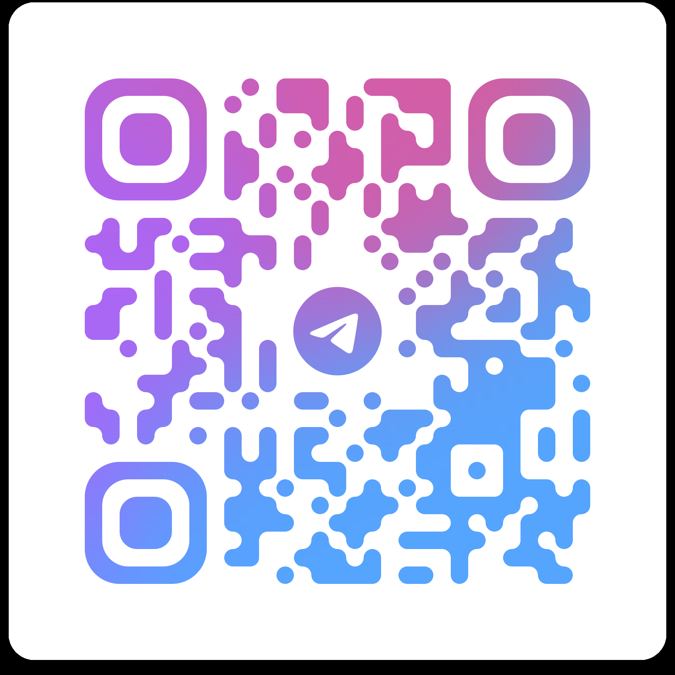
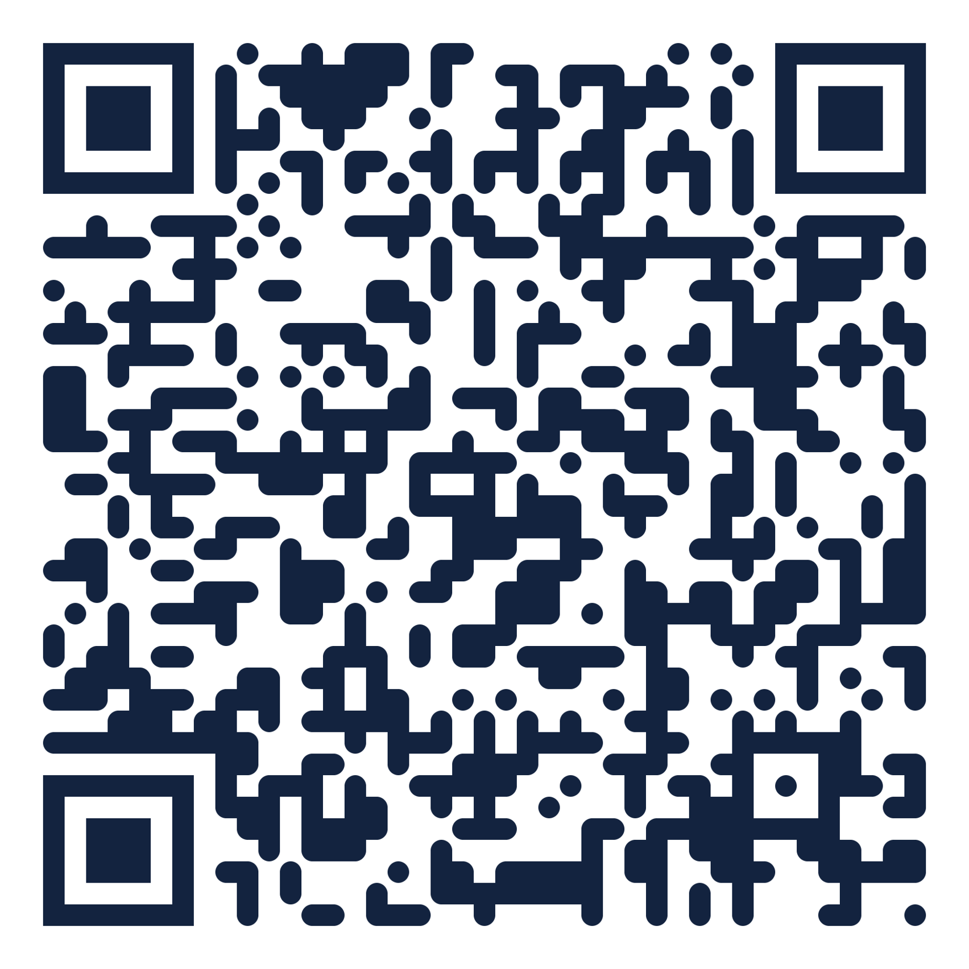
Questions?
CONTACT ME
Eng. Mohamed Shehab
mohamed.shehab.fci@gmail.com
telegram @shebo280
Faculty of Computers and Information
Menoufia University
Telegram group
Recordings
questions between sessions
every session, in order
Software Engineering 2 · Week 4 · Locators and Assertions — this session is video 4 in the playlist
Install Postman before next week. The task is due at the start of section 5.

